Slide 1
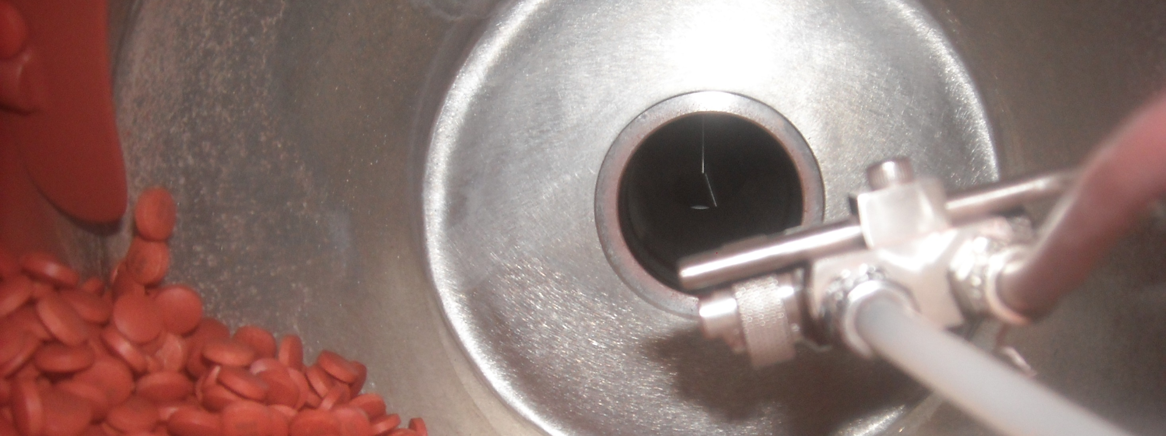
VA Cooperative Studies Program (CSP) Clinical Research Pharmacy Coordinating Center (CRPCC)
Quality New Mexico
Leadership Series

Slide 2
CRPCC Overview
Mission, Vision, Values
Context of the Organization
Structure
Culture of Quality
Outcomes
Questions

Slide 3
What is a Clinical Trial?
An experiment in humans comparing the effect and value of an intervention against a control
Intervention can be a drug, device or strategy intended to treat or prevent disease
Control can be no treatment, a different treatment, or a placebo
A highly regulated activity!

Slide 4
Mission of the Cooperative Studies Program
To advance the health and care of Veterans through cooperative research studies that produce innovative and effective solutions to Veteran and national healthcare problems.

Slide 5
PCC Mission
To improve the health of our Nation’s Veterans by providing creative pharmaceutical solutions to global clinical research
PCC Vision
We will become the premier provider of pharmaceutical services for clinical trials, with highly engaged employees who are focused on exceeding customer expectations
PCC Values
Build Enduring Relationships
Respect those I Serve and With Whom I Work
Adopt a “Can-do” Attitude
Seek Excellence
Act with Integrity
Notes:
Whenever we think about strategic planning and how we will adapt to the current environment, I think it helps to remind ourselves of who we are, the culture we’re trying to foster, and why we exist. These are summarized in our Mission, Vision, and Values.
PCC Values: Build enduring relationships with employees, customers, and our communities
Respect all those I serve and with whom I work by treating them with dignity and courtesy
Adopt a “Can-Do” attitude, using resourcefulness, creativity and innovation to improve our products and services
Seek excellence, striving for the highest quality in everything I do
Act with integrity, inspiring trust and confidence in all my interactions.

Slide 6
VA CSP CRPCC
Organizational Chart
Veterans Administration
Legend
Direct Report and Oversite
Administrative Support
Research Support
Veterans Health Administration
Office of Research and Development
BRINM
NMVAHCS
Cooperative Studies Program
Genomics Lab
Pharmacy
Center
5 Biostatistical Centers
4 Epidemiology Centers
9 NODES

Slide 7
VA Cooperative Studies Program

Slide 8
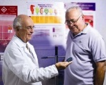
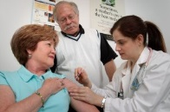
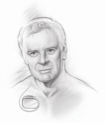
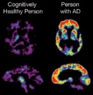
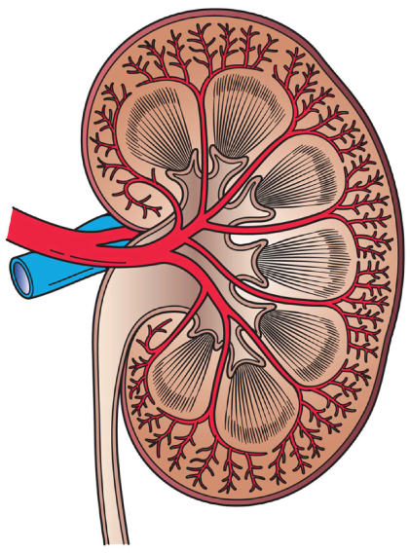
VA COOPERATIVE STUDIES PROGRAM
Our research changes the practice of medicine
The VA Cooperative Studies Program (CSP) is the Division of VA Research and Development that is responsible for the planning and conduct of large multicenter clinical trials and epidemiological studies in the VA. For decades, VA CSP has been involved in finding effective strategies in a range of diverse conditions that affect Veterans, ultimately benefiting Veteran health and well-being.
CSP 18
Protective Effects of Aspirin Against Acute Myocardial Infarctions
ACCORD & VADT (CSP 465)
Intensive Glucose Lowering in Type 2 Diabetes
SELECT (CSP 499)
Vitamin E and
Cancer Prevention
SPRINT
Blood Pressure Intervention
1983
…
2005
2008
…
2009
…
2011
…
2014
2015
2017
CSP 403
Shingles Prevention Trial
CSP 546
Alzheimer’s
Research
CSP 563
PTSD
CSP 578
Diabetic Kidney
Disease
CSP 468
Deep Brain Stimulation
Notes:
This is an overview of the landmark studies we have completed that have impacted clinical practice for not only the veteran but the world.
First is our study in 1983 that found giving aspirin would help prevent heart attacks, this is the study where we got an aspirin a day recommendation
CSP 18
Aspirin has a protective effect against AMI in men with unstable angina.¹
In 2005 the results from the shingles study lead to the approval of the vaccine in adults over 60 years old.
The two diabetes studies found that maybe lower blood sugars is not as beneficial as we once thought
ACCORD and CSP 465
Intensive glucose control in older people with Type 2 Diabetes may result in more risk than benefit.3
In 2009 this study found that DBS was more effective than taking medications for Parkinson’s
CSP468
Deep brain stimulation was more effective than best medical therapy for patients with advanced Parkinson's.⁴
In this study, we found that what was universally thought of as a safety medication that the supplementation of Vit E increased the risk of prostate cancer in a trial designed to examine if it would help prevent prostate cancer.
CSP499
Dietary supplementation with vitamin E significantly increased the risk of prostate cancer among healthy men in this primary prevention trial.
In 2014 for the first time we found a treatment that could potentially slow the functional decline in alzheimers disease with vit E
CSP 546
Vitamin E resulted in slower functional decline
The most recent pivitol study in blood pressure, found that targeting a blood pressure below was current guidelines suggest found better heart-related outcomes and reduced death
Sprint
Found for individuals at high risk for cardiovascular events but without diabetes, targeting a lower systolic blood pressure than previously recommended provided better CV and death outcomes but not without significantly higher risks of adverse events for some.⁷

Slide 9
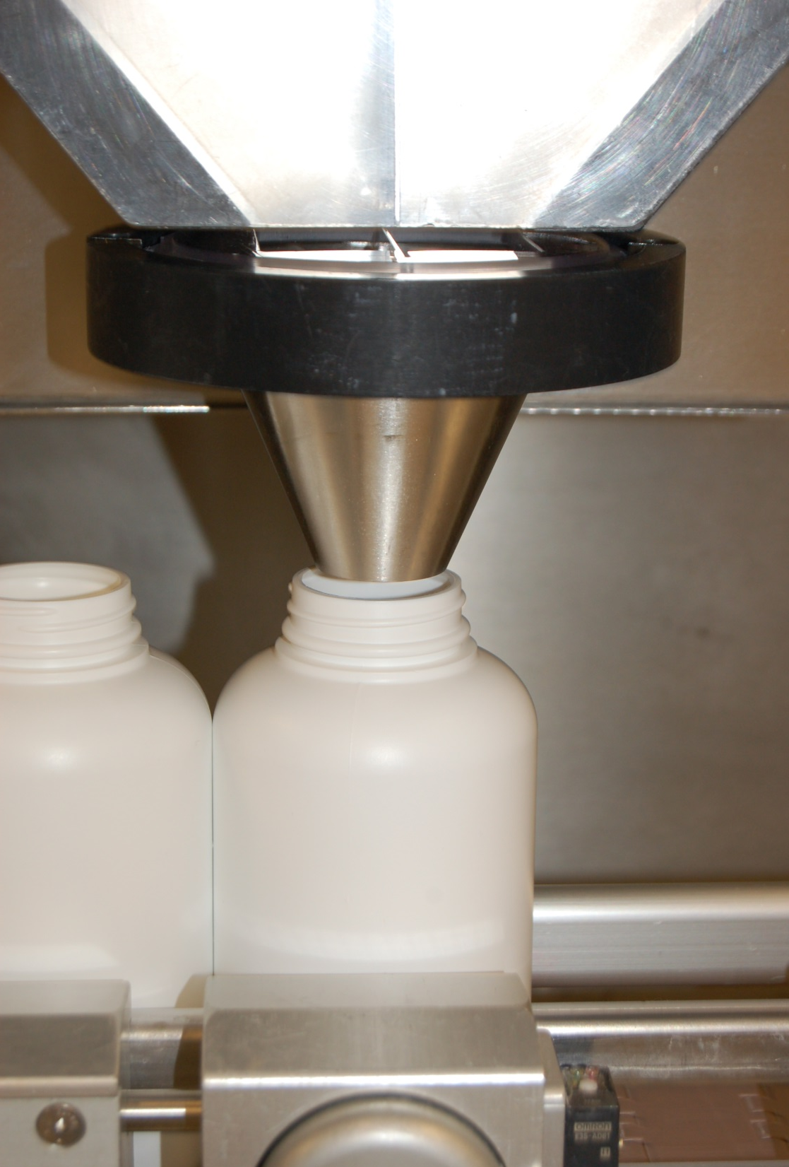
Clinical Research Pharmacy Coordinating Center— Core Functions
Regulatory and Patient Safety Management
Pharmaceutical Project Management
Manufacturing, Packaging, Labeling and Distribution of Investigational Drug Product and Clinical Trials Materials
Performance Excellence Management– Total Integrated Performance Excellence System (TIPES)
Notes:
Provides drug and device support to VA’s multi-center clinical trials
Includes the design, development and distribution of clinical trials materials
Provides participant safety support through the Regulatory Affairs and Compliance Section
Ensures adherence to regulatory requirements through the Study Monitoring and Auditing Resource Team (SMART).

Slide 10
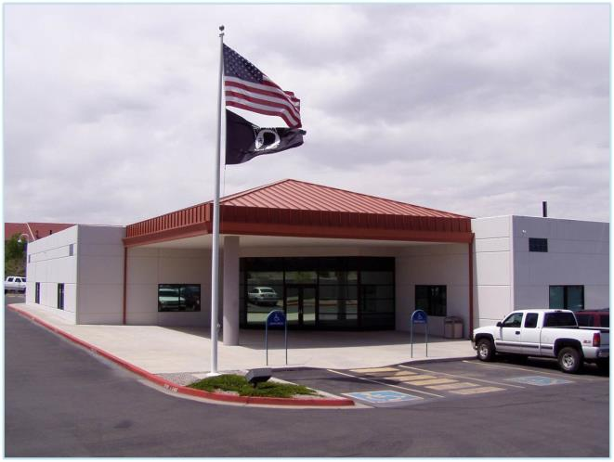
CRPCC Organization
Division of Administrative Operations (DAO)
Administration (ADMS)
Finance (FS)
Workforce and Learning Support (WSLS)
Division of Quality Assurance (DQA)
Quality Control (QC)
Regulatory (RACC)
Site Monitoring, Auditing & Review Team (SMART)
Laboratory (BPLS)
Division of Study Design and Management (DSDM)
Study Design
Study Planning
Study Management
Division of Technical Operations (DTO)
Clinical Manufacturing (CMS)
Clinical Materials Management (CMMS)
Information Technology (ITS)

Slide 11
FDA registered as a Drug Establishment (drug manufacturing and packaging registration) DEA registered for controlled substances research and distribution Registered to two ISO standards: 9001 (General Quality Management) 21500 (Conformance to Project Management) Lab is accredited by College of American Pathologists and has a CMS CLIA Certificate
REGISTRATIONS AND ACCREDITATIONS

Slide 12
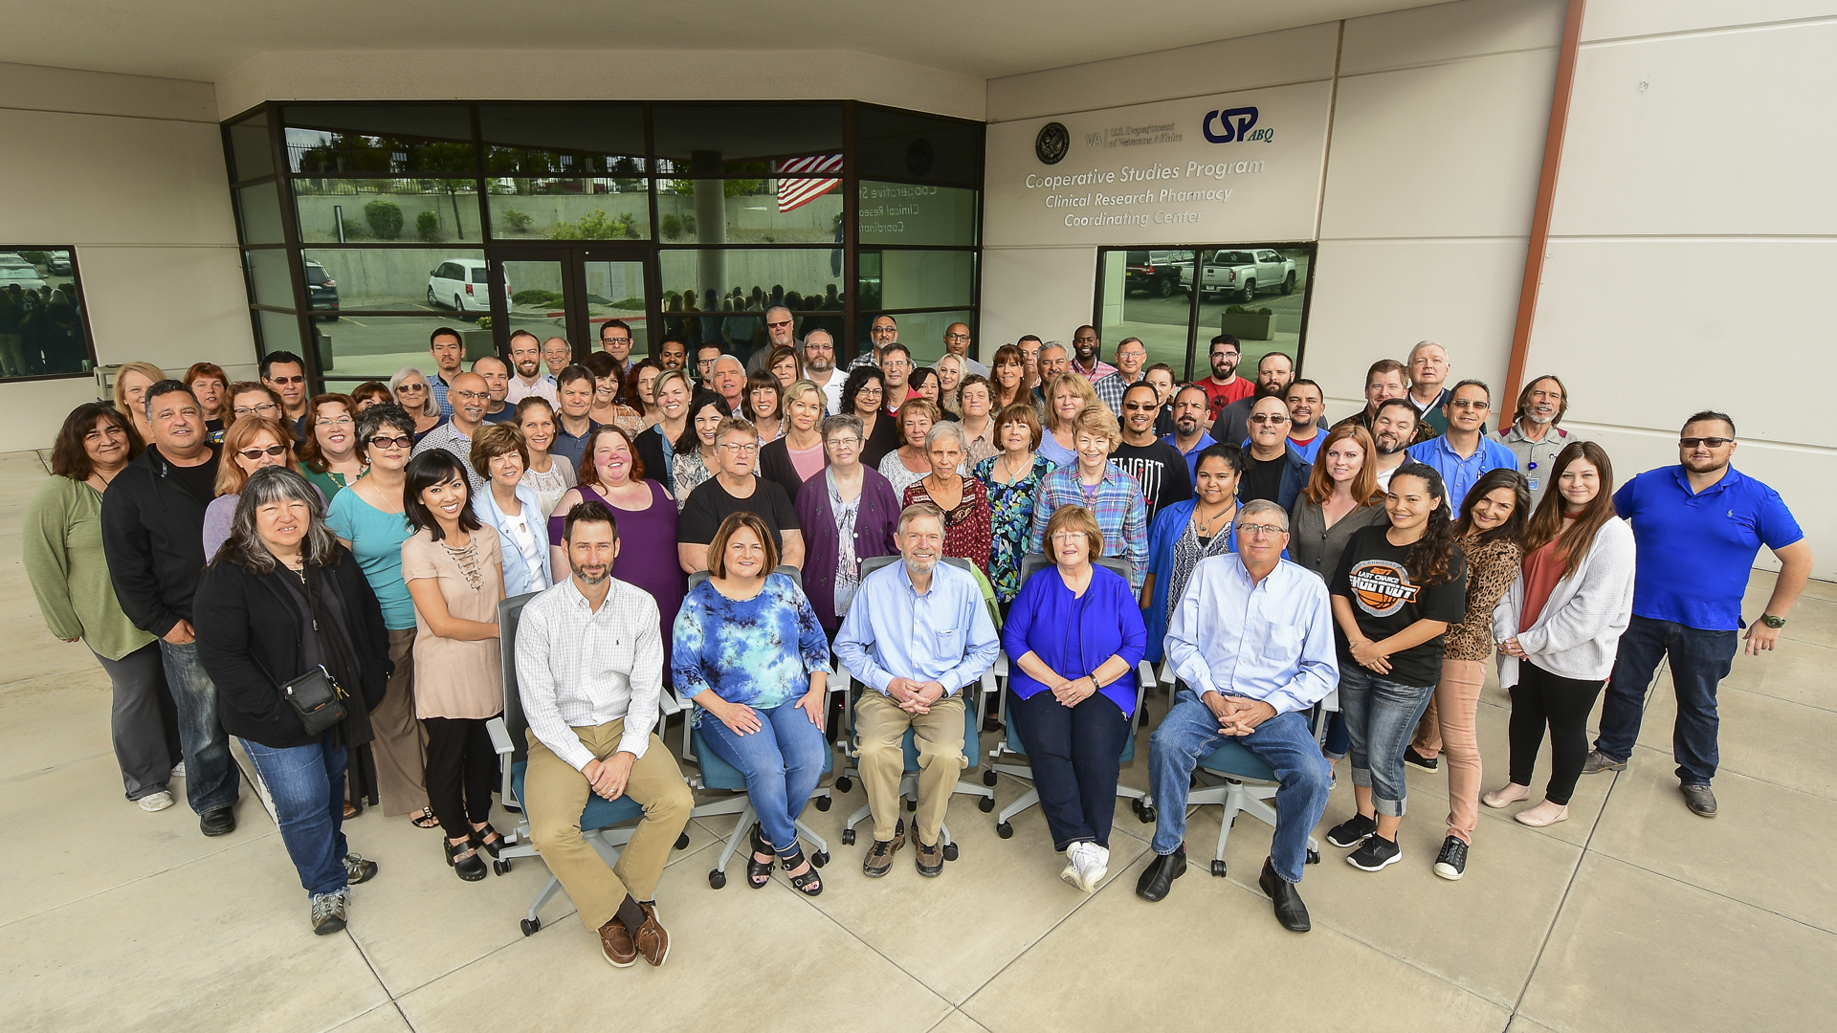
Demographics of the CRPCC
We have over 100 employees
Support up to 70 active trials at a time
90,000 study participants who have contributed to the study of over 300 drugs and devices at 1,600 sites

Slide 13
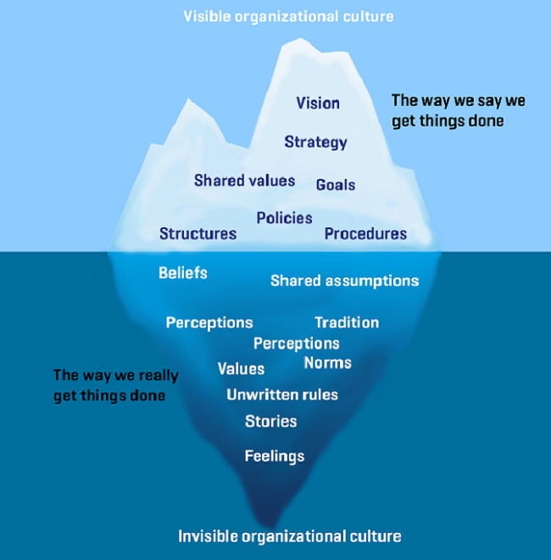
Center Culture “Culture Eats Strategy for Breakfast.”

Slide 14
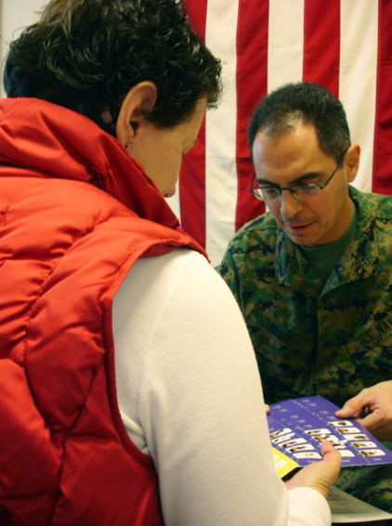
Culture of Quality/ Performance Excellence

Slide 15
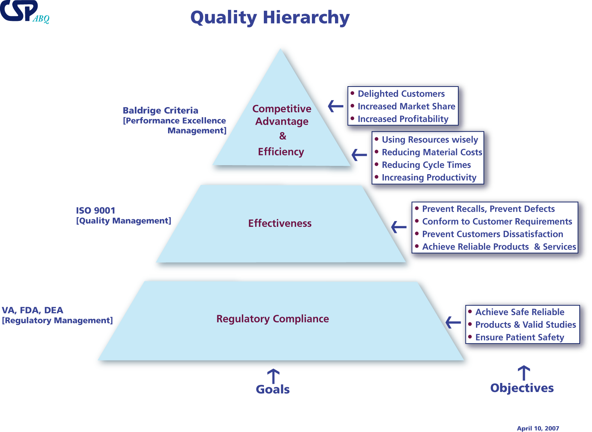

Slide 16
Notes:
Progression of Excellence. Last updated July 2014

Slide 17
Engagement Across CSP Centers Compared to the US Govt
Gallup U.S. Gov’t 75th: 3.85
 | CSP Overall |  |  | Albuquerque |  |  | Boston |  |  | West Haven |  |  | Perry Point |  |  | Palo Alto |  |  | Hines
Yr. | ’14 | ’15 | ’16 | ’14 | ’15 | ’16 | ’14 | ’15 | ’16 | ’14 | ’15 | ’16 | ’14 | ’15 | ’16 | ’14 | ’15 | ’16 | ’14 | ’15 | ’16
N= | 328 | 327 | 310 | 92 | 88 | 85 | 89 | 92 | 95 | 37 | 38 | 30 | 33 | 36 | 30 | 40 | 37 | 35 | 36 | 36 | 32
Copyright © 2017 Gallup, Inc. All rights reserved.

Slide 18
75th Percentile 3.85

Slide 19
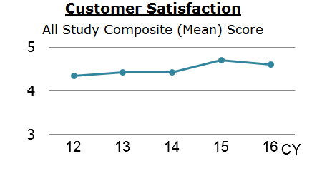

Slide 20
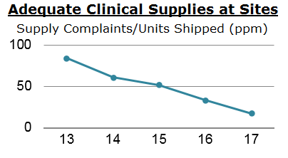
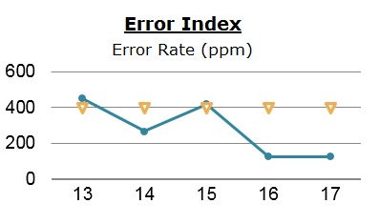

Slide 21
Questions?

